Slide 1
Activity 1
Harrison Knight

Slide 2
Flame Sensor Circuit Ground Rules
For each sensor, a 1 will correspond to a detected flame and a 0 will correspond to no detected flame, or a sensor failure. In order for the circuit to push the waste inlet to a 1 (waste entering exhaust), at least 2 of 3 sensors must be a 1.

Slide 3
Truth Table
A | B | C | 1 for detected, 0 for not | Waste Valve (F) | 1 for open, 0 for closed
0 | 0 | 0 |  | 0
0 | 0 | 1 |  | 0
0 | 1 | 0 |  | 0
0 | 1 | 1 | 2 of 3 | 1
1 | 0 | 0 |  | 0
1 | 0 | 1 | 2 of 3 | 1
1 | 1 | 0 | 2 of 3 | 1
1 | 1 | 1 | 3 of 3 | 1

Slide 4
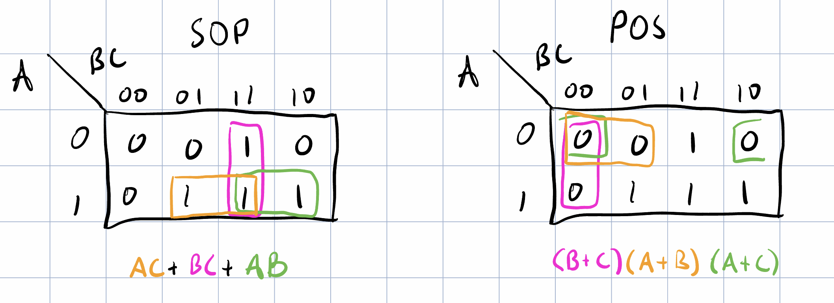
K Map for SOP and POS

Slide 5
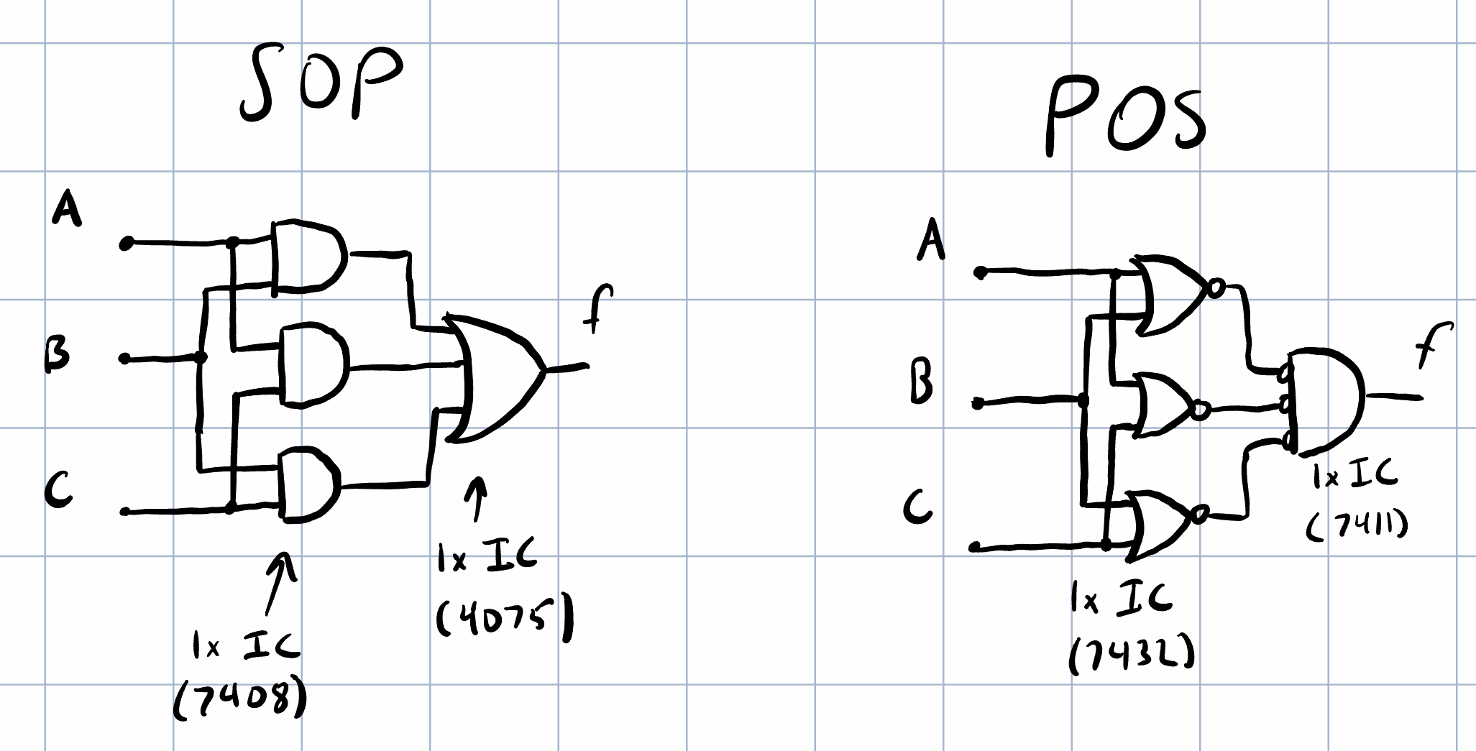
Digital Circuits for SOP and POS

Slide 6
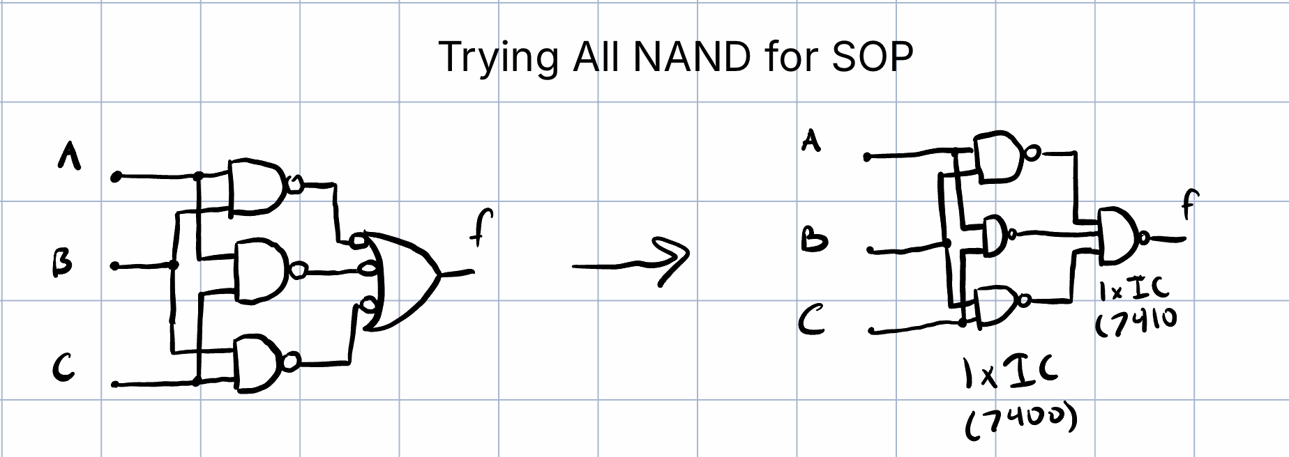

Slide 7
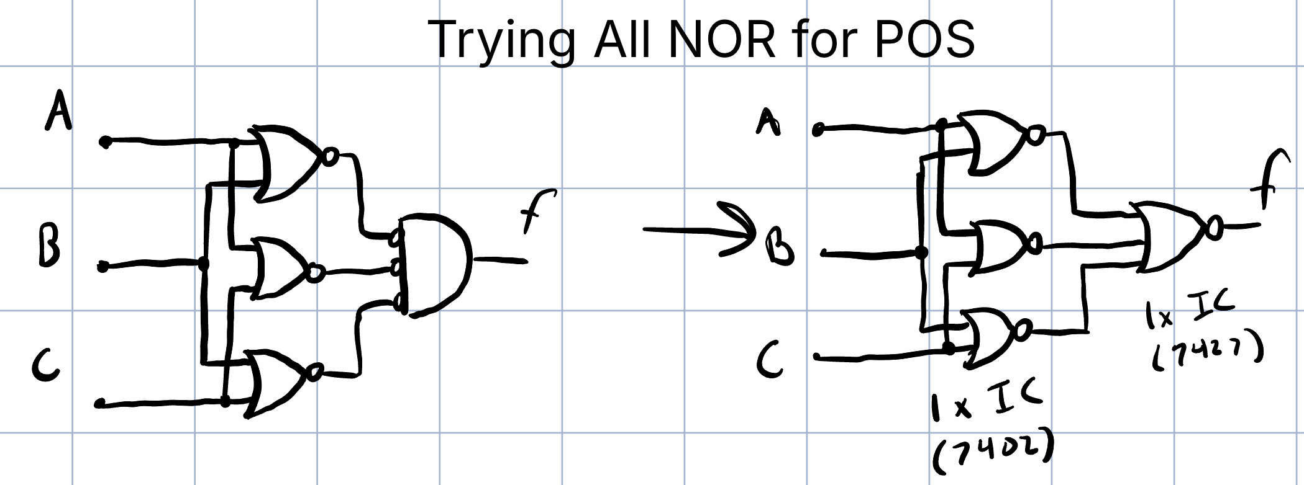

Slide 8
Conclusion for part a
For part A we have the option to use the SOP or POS with all NAND or all NOR. I choose all NAND because I like it more

Slide 9
Sensor Disagreement Circuit Ground Rules
For any of the “disagreement” cases (010, 100, 101, etc.), a 1 will be triggered in the output, which can be used to trigger an alarm system.

Slide 10
Sensor Disagreement Truth Table
A | B | C | Sensor Disagreement (1 = Alarm) (G)
0 | 0 | 0 | 0
0 | 0 | 1 | 1
0 | 1 | 0 | 1
0 | 1 | 1 | 1
1 | 0 | 0 | 1
1 | 0 | 1 | 1
1 | 1 | 0 | 1
1 | 1 | 1 | 0

Slide 11
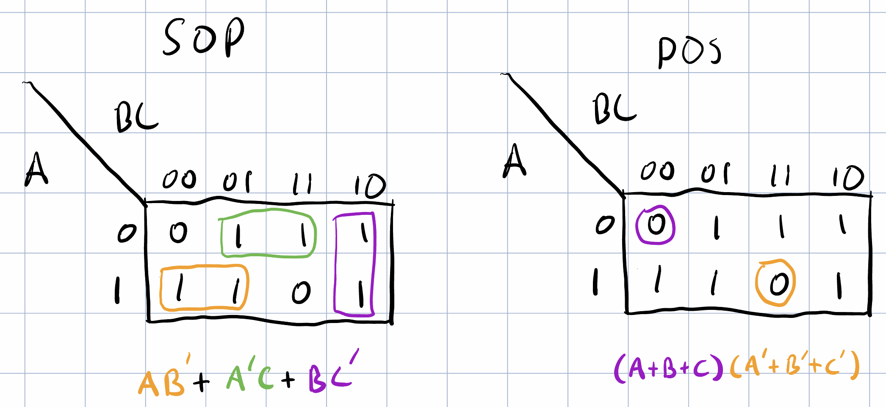
Karnaugh Maps for Sensor Disagreement

Slide 12
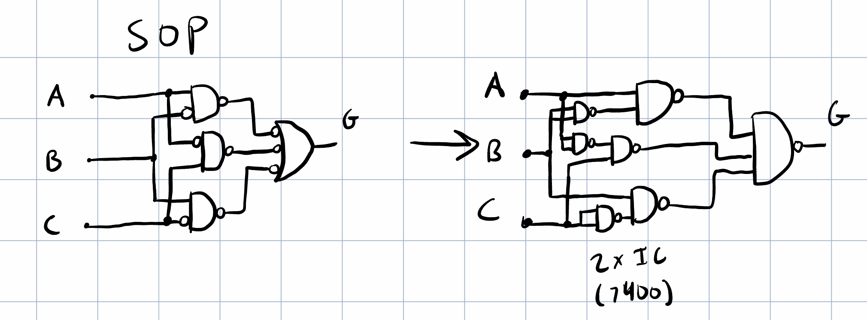
Digital Circuits – We don’t have Inverters

Slide 13
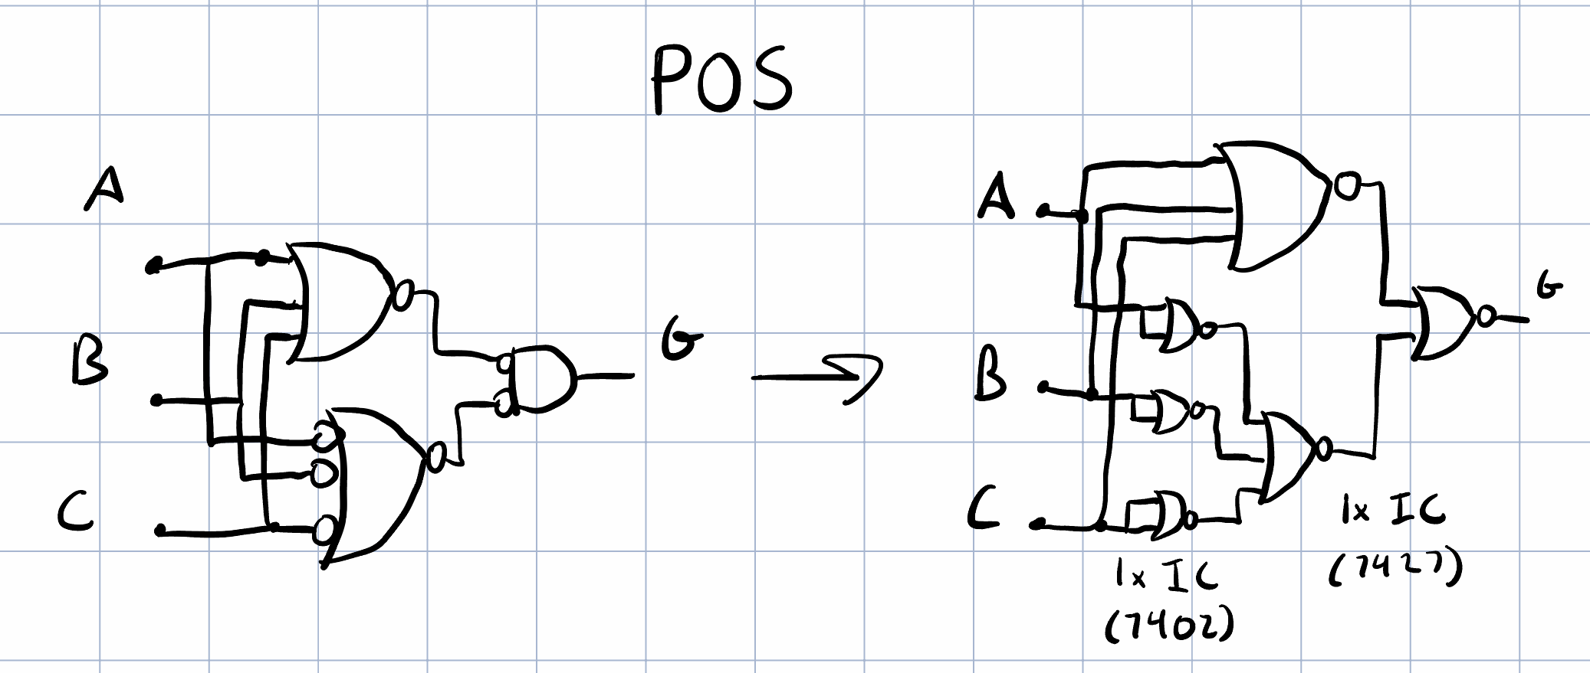
Digital Circuits – We don’t have Inverters

Slide 14
Conclusion for part b
Again, we have the option between all NAND and all NOR because they both use the same number of ICs. I choose all NAND.

